Slide 1
Ovia Health App
(Coding Exercise)
- By Gaurav Shah

Slide 2






Gateway
Ovia Health App
Patients
App Backend
Partner FHIR
endpoint

Slide 3
Requirements
Support different types of incentive events
User logged data five days in a row
User reported a birth
Identify and record when a user achieves a certain incentive

Slide 4
Coding
User interface to log information
API Implementation
Status block to visualize data

Slide 5
Design
I have provided form to simulate type of activity that app can monitor along with date field to allow evaluator to simulate themselves.
On right, there is status block which shows the data that’s being stored.
Counter to track consecutive reporting days gets reset when user earn an incentive.
When there is incentive bein earned, you will see success alert with green background or else it uses info alert in yellow color.

Slide 6
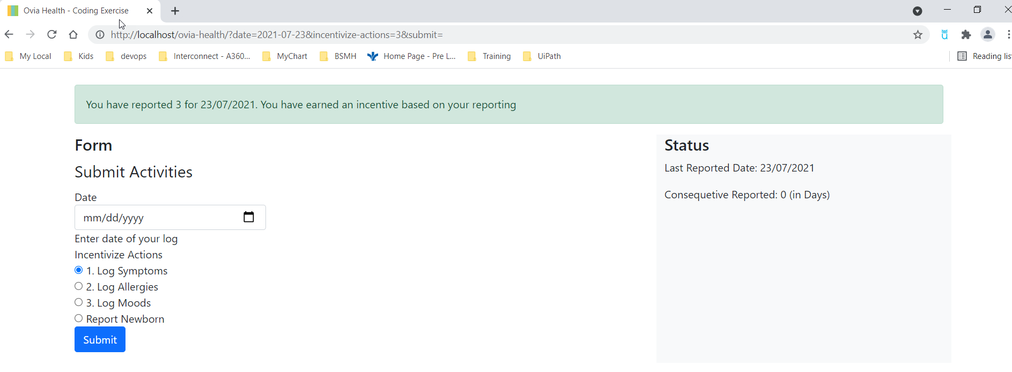
Incentive – 5 consecutive days submission

Slide 7

Incentive – on new born repoting

Slide 8
Integration
In order to share the user incentive achievements with incentive-managing partners outside of Ovia Health, we can achieve this based on various ways
Direct HER integration – HL7 interface (receive HL7 message directly from EMR system to queue and process it)
API – We can use FHIR api as it’s becoming health care’s standard as part of meaningful use. So, we can leverage this and be able to get patient’s change to the record
App Integration – We could also place our code in EMR vendor’s app store and let our managing partner integrate with thei EMR. Once we have integration in place, we can use SSO to allow patients to start using themselves.

